Slide 1
Object Oriented Programming(OOP)
Option1 : Self Learning
Option 2: Annex 2

Slide 2
Environment Design Curriculum
Environment Design
Game Design
Player Class
Sprite
Enemy Class
Collision
Deep Q-Learning Agent
Environment Class
Training Agent

Slide 3

Environment Design
To solve our problem we need own environment
Pygame (pybox2d, arcade, pymunk)
Pygame (game library): is a set of tools to help making games
graphics and animation
sound
control: mouse and keyboard

Slide 4
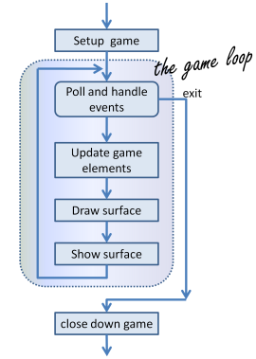
Game Loop
Game loop:
process input (event:mouse click)->
update game (change) ->
render (draw everything on screen) ->
clock(fps))

Slide 5
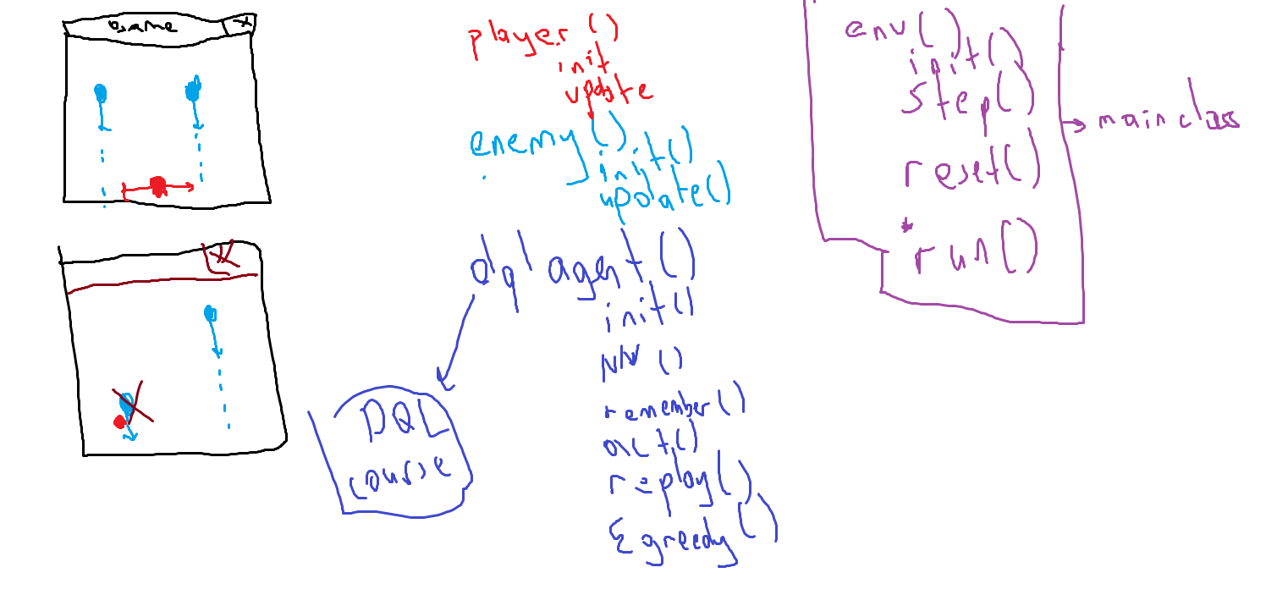

Slide 6
Environment Design Results
Environment Design
Game Design
Player Class
Sprite
Enemy Class
Collision
Deep Q-Learning Agent
Environment Class
Training Agent

